Slide 1
Project 3 Group 6
Yan Chen, Auyon Haque, Shengwei Jiang, Hanqi Lin, Zackaria Mamdouh, Prithibi Paul, Sabrina Zheng, Alexa Amaya

Slide 2
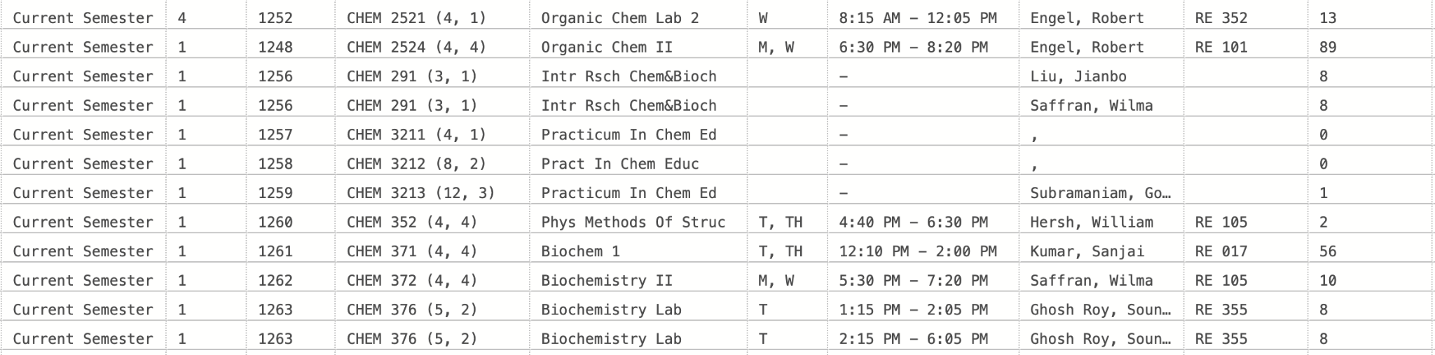
Data Cleansing
While looking through the database immediately after backup we noticed the multiple instance with missing values, ranging from the day, time, location and instructor.
To correct the data that was missing we considered many things but ended up deciding that you would gain the most functionality from the database if we enter placeholder values
We ended up deciding that using TBA for the instructors, day and time that were null made the most sense as it’s the practice currently used by Queens and it provides information and ensure there are no null values.

Slide 3
Naming Conventions
CREATE TABLE [Course].[Course]
(
[CourseKey] [Udt].[SurrogateKeyInt] NOT NULL IDENTITY PRIMARY KEY,
[CourseName][udt].[CourseName] NULL,
[CourseDescription] [Udt].[CourseDesc] NULL,
[UserAuthorizationKey] [Udt].[SurrogateKeyInt] NOT NULL,
[DateAdded] [Udt].[DateOf] NULL
DEFAULT SYSDATETIME(),
[DateOfLastUpdate] [Udt].[DateOf] NULL
DEFAULT SYSDATETIME()
);
When deciding upon naming conventions we decided that it’s best to use a naming convention that is most intuitive as we want to promote a cohesive design and be consistent..
I’ve inserted a block of code where we create the course table, naming it Course and the primary key CourseKey were part of us wanting to ensure the functionality of the database would be clear just by seeing the tables that make it up.
This also made implementing our ERD diagram much easier as we were able to map from the diagram to the database one to one

Slide 4
Hierarchy and Reuse of UDTs
Intuitive naming and self documenting facilitates mapping between our ERD and the database due to making the relationships and connections significantly clearer than they would be otherwise
Using self-documenting UDT names for all the columns makes it so that there's clarity and consistency within the database as the column name makes its purpose clear to the user immediately

Slide 5
Constraints
There are the more obvious constraints that should always be implemented such as not allowing for null primary keys but we were also sure to implement constraints that would ensure that the person who was altering the table’s authorization key was recorded as well as the DateAdded or DateOfLastUpdate
CREATE TABLE [Course].[ModeOfInstruction] (
[ModeOfInstructionKey] [Udt].[SurrogateKeyInt] IDENTITY (1, 1) NOT NULL,
[ModeOfInstruction] [Udt].[ModeOfInstruction] NOT NULL,
[UserAuthorizationKey] [Udt].[SurrogateKeyInt] NOT NULL,
[DateAdded] [Udt].[DateOf] DEFAULT (sysdatetime()) NULL,
[DateOfLastUpdate] [Udt].[DateOf] DEFAULT (sysdatetime()) NULL,
PRIMARY KEY CLUSTERED ([ModeOfInstructionKey] ASC)
);

Slide 6
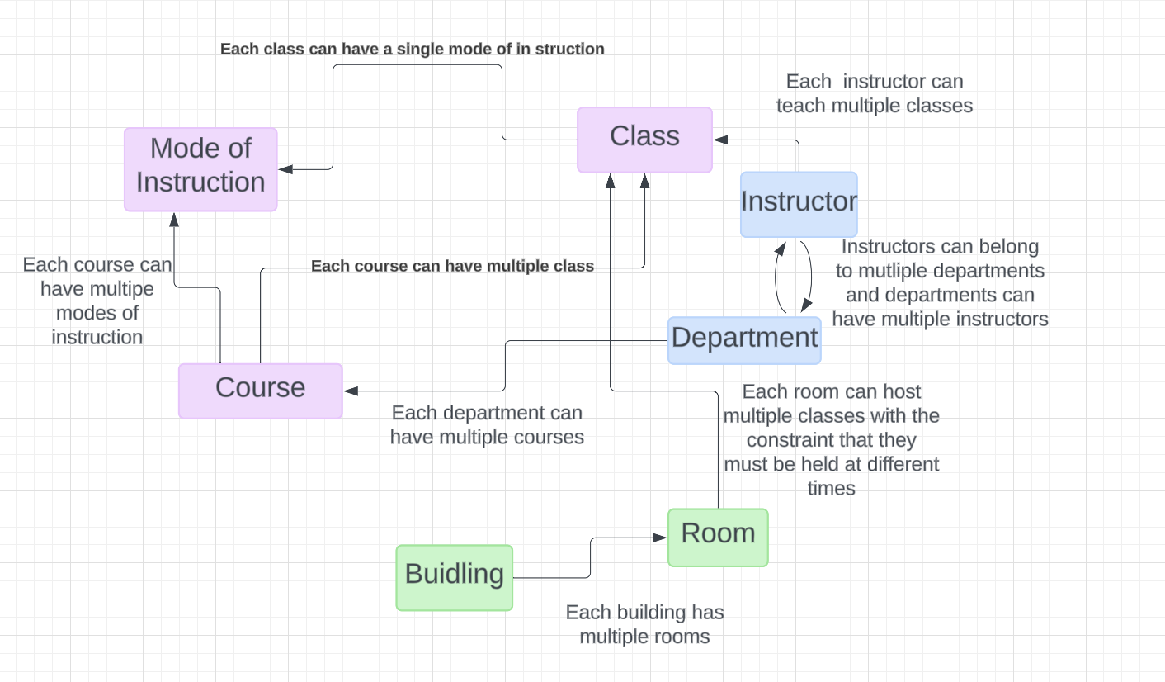
Conceptual Data Model

Slide 7
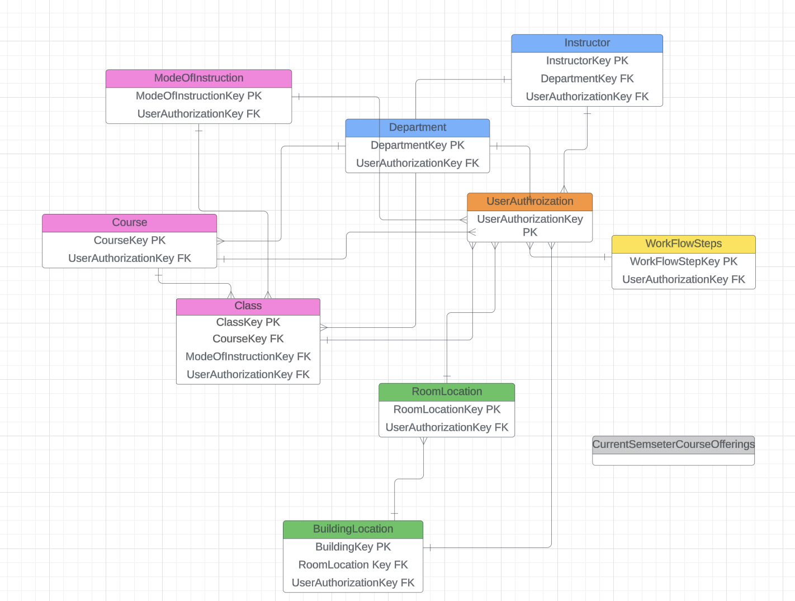
Logical Data Model

Slide 8
NACE Competencies
We did our best for this project to focus on implementing at least three NACE Competencies
Career & Self-Development
Teamwork
Communication
The choice of focus on career and self-development was to push for us all to keep in the front of our minds the valuable skills that we’re developing by working on this project
The focus on teamwork is obvious! There are many of us in the group and we aimed to take advantage of that by dividing work appropriately
Because we’re such a large group, we figured that communication would be difficult at times since it’s the end of the semester, we did our best to keep each other in the loop and communicate any issues we encountered.

